Slide 1
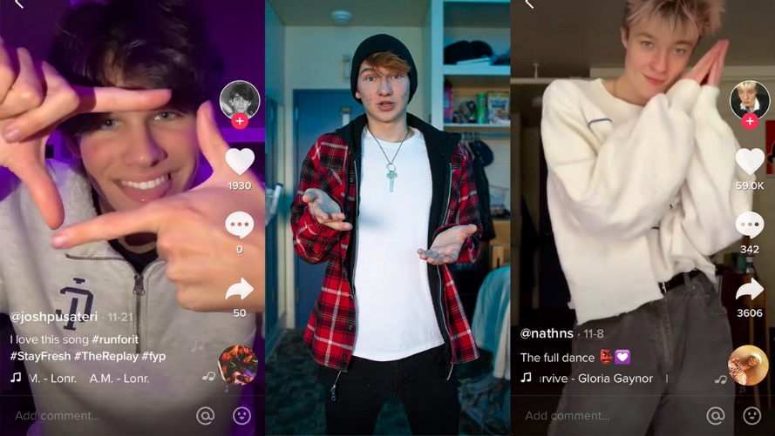
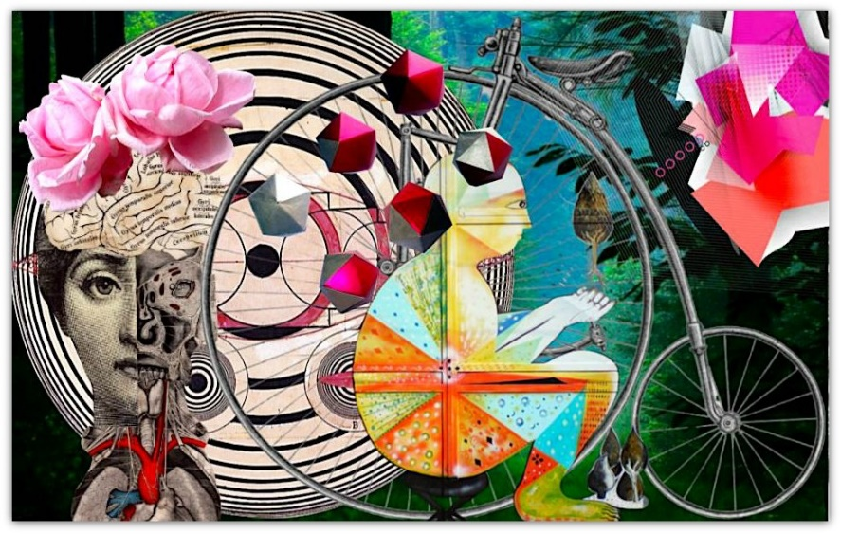
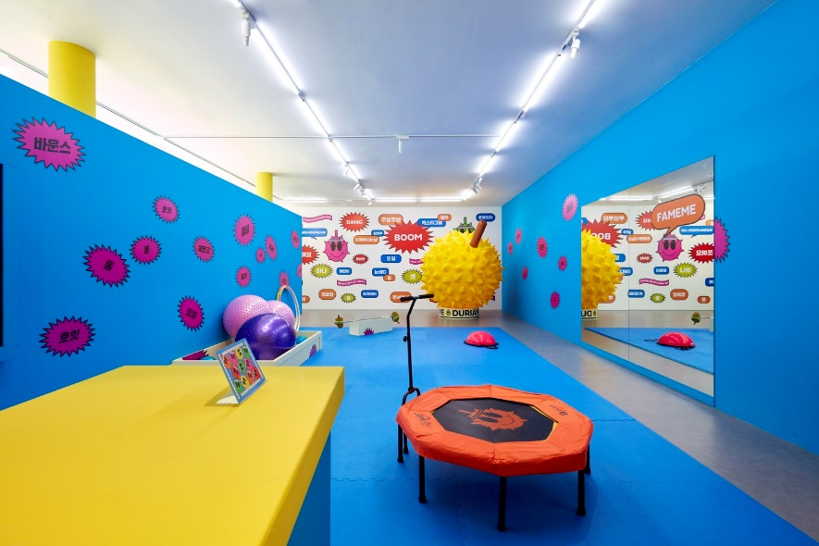
Conversation class
Self Expression
Social Media
What you see v What you don’t
(White space)
Image v online
Honesty v fake
Self expression - Too far ?
Labels
Music
Dance
Mask
Spontaneous
Colour
The art of being yourself
https://youtu.be/veEQQ-N9xWU
Christopher bAUMAN

Slide 2
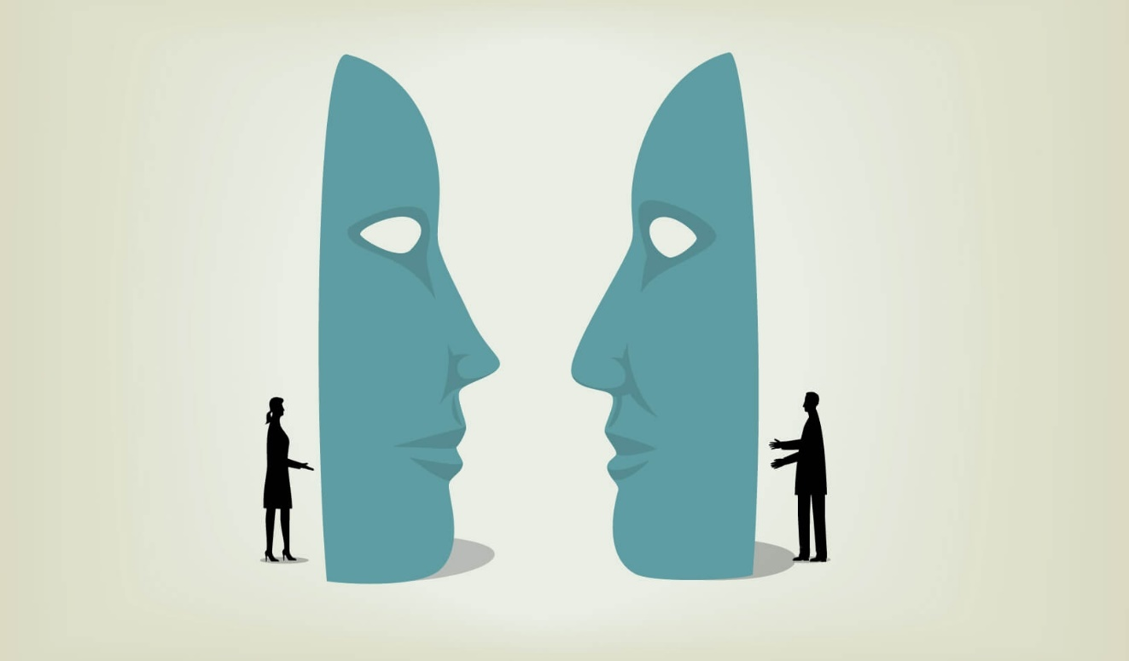
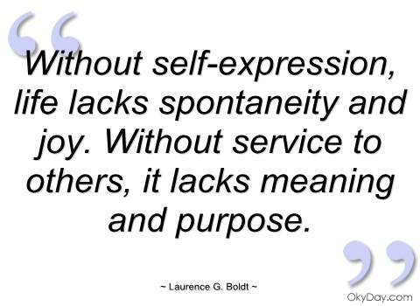
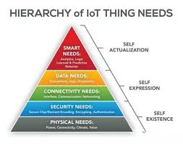
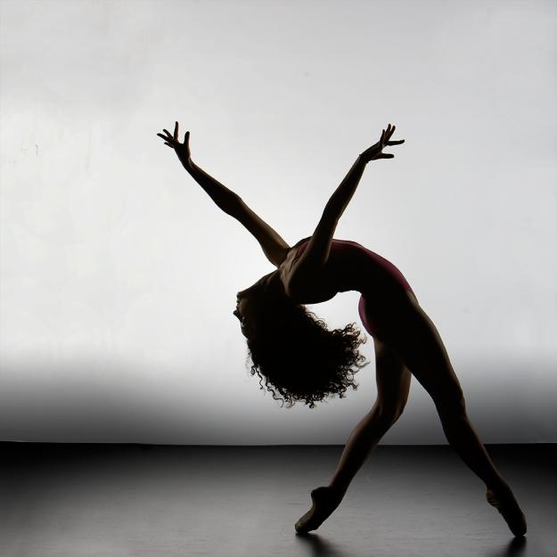
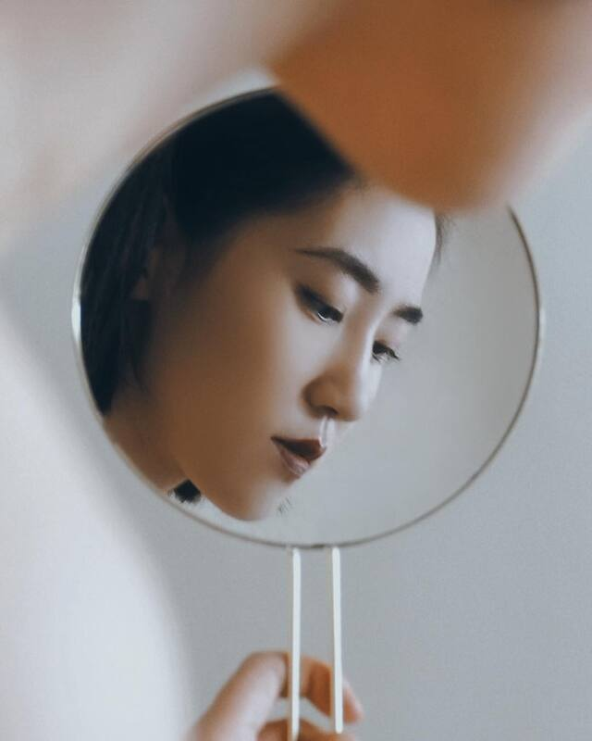
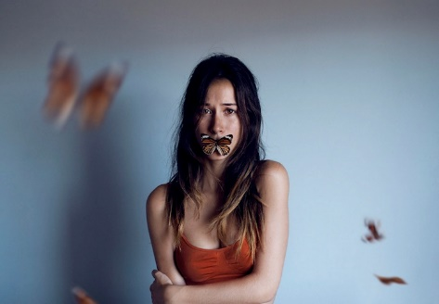
Education Infographic
Photo competition…
Happy
Unhappy
Emotional
Thoughtful
Scared
Inspiring
Help
Teachers
Education
Skills
Chris Bauman

